Slide 1
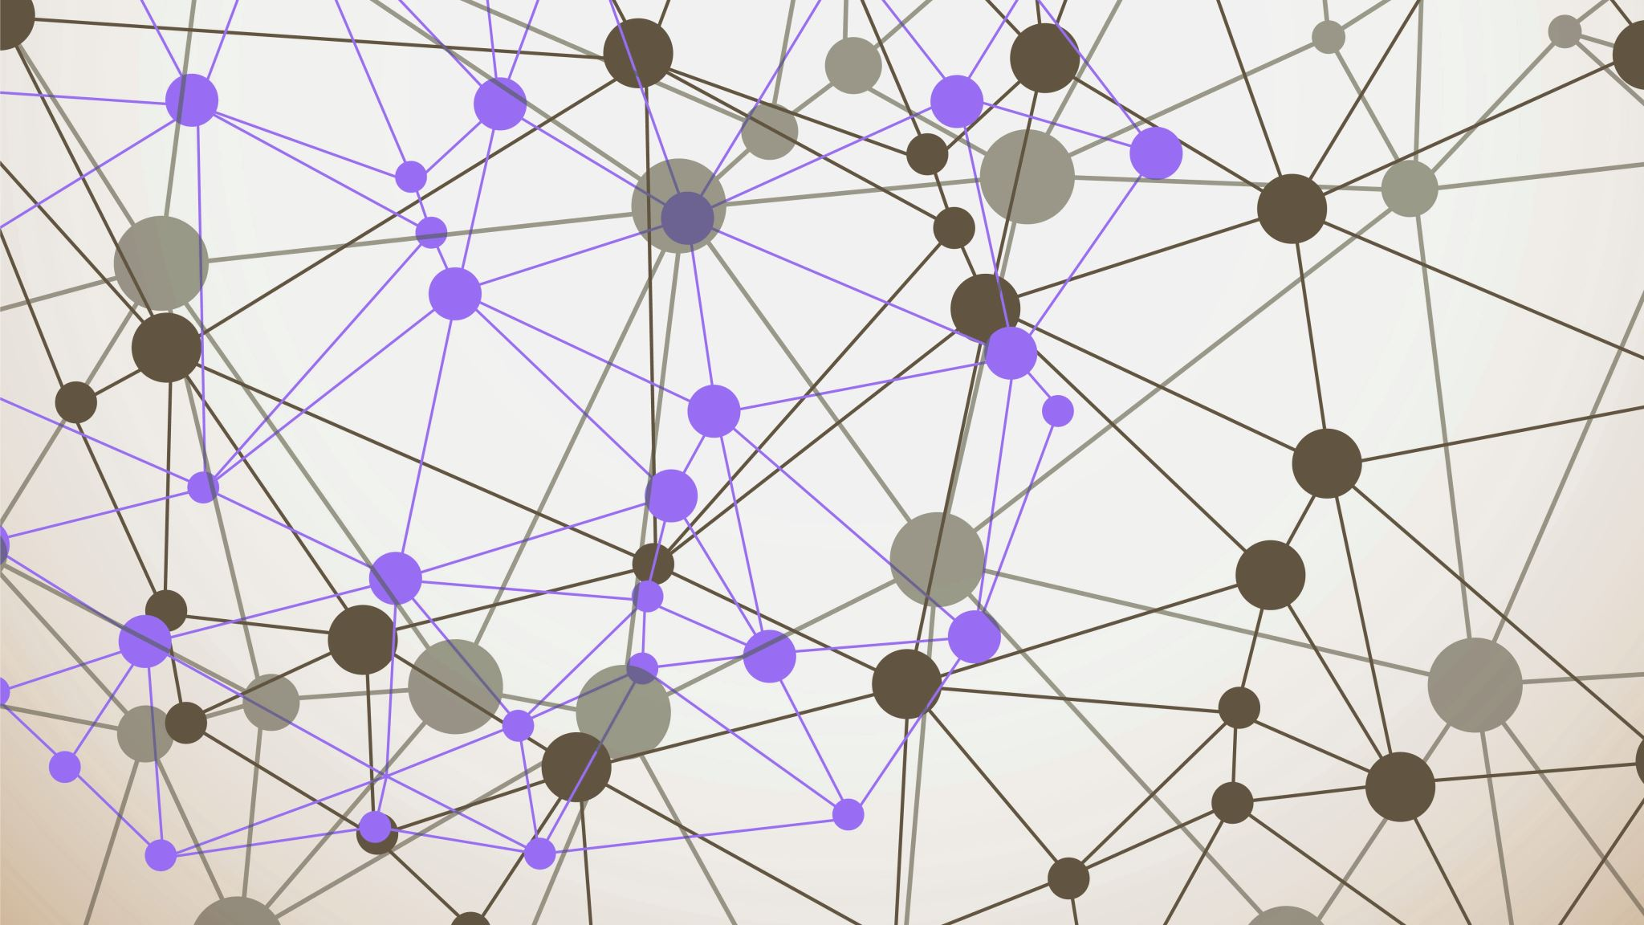
Web Scraping Research Project
By: Neeraja Vasa

Slide 2
Task
Read the award data on the website https://science.osti.gov/early-career
Extract the names of the awardees and their institutions
Classify awardees as male or female
Classify the institutions as universities or national lab
If an institution is a university, classify it as public, private, or ivy league
Find the h-index of each recipient on google scholar

Slide 3
Libraries Used
To help with this project, I used the following libraries:
requests: to fetch web pages and download files
BeautifulSoup: to parse HTML contents to find elements
os: to perform file system operations like creating directories or checking if a file exists
urllib.parse.urljoin: form URLs by joining relative paths to URLs
tqdm: progress bar for loops
pdfplumber: extract text from PDF files
re: regular expressions for searching and extracting patterns from text
pandas: data manipulation and storage in tabular manner
gender_guesser: library that guesses gender based on first name

Slide 4
Libraries Used
logging: to log messages for debugging and progress tracking
scholarly: access Google Scholar to retrieve information

Slide 5
Setting up
Configuring logging to log messages in a readable format
Saving the website from which we have to read data
Creating directories to store PDFs and their extracted text files.

Slide 6
Step 1: Fetching PDF links
Send a GET request to the base URL
Raise an exception if there was an error accessing the URL
Use BeautifulSoup to parse through the content of the website and find the links for pdf files
Storing the links in a list
download_pdf method:
Takes in two parameters: the URL of the file to be downloaded and the path it must be saved in
Makes a request to the URL, stream=True ensures that data is downloaded in chunks
If the URL is found, it opens a new file at that path in “wb” mode
PDF is downloaded in chunks. Chunk size is defined by chunk_size
Each chunk is written to the file
download_pdfs method takes in a list of PDF URLs and the directory the PDFs must be saved at

Slide 7
Step 2: Extracting text from the PDFs
extract_text_to_txt method
Opens a PDF file
Going through each page of the PDF and extracting text from it
Writing the extracted text to a new file and saving it
extract_texts
Going through each pdf and extracting the text from it

Slide 8
Step 3: Extracting Names and Institutions
Initializing the gender detector and setting it to not be case sensitive
Defining lists of national labs, public universities, private universities, and ivy leagues
categorize_institution method
Categorizes each institution accordingly
classify_gender method
Used gender_guesser to guess the gender of the awardee
extract_entries_from_text method
Extracts the name of the awardee and their institution from the given text
Split

Slide 9
Step 3: Extracting Names and Institutions
extract_entries_from_text method
Extracts the name of the awardee and their institution from the given text
Splits each PDF file based on new line character (new line character indicates a new page)
A list called entries is created to store (Name, Institution) pairs
Storing a list of keywords to avoid checking for departments of an institution
Checking for lines that start with Dr.
Extracting their name
Looking for a line with a zip code and moving one or two lines above that to find the institution name

Slide 10
Step 3: Extracting Names and Institutions
extract_and_classify_data method
Identifies text files within the directory and loops through each of them
Extracts the names and institutions from the text files
Guesses the gender based on first name
Classifies institution
Creates a DataFrame to store each entry

Slide 11
Last Step: Execution
Calling all the methods we defined
Converting the DataFrame to a .csv file
index=False ensures that the Data Frame’s index isn’t included in the csv file
if __name__ == "__main__“
Ensures that the main method is called only when the script is run directly, not when it is imported as a module in another script

